Slide 1
Feature subset selection using Filter methods
Prof.Aruna Malapati

Slide 2
Learning Objectives
Formulate the problem of filter methods for feature subset selection
List various filters
Define the Pearson correlation filter for regression
Explain no free lunch theorem

Slide 3
Filter Methods
The Predictive power of individual feature is evaluated.
Rank each feature according to some univariate metric and select the highest ranking features.
The score should reflect the discriminative power of each feature.
Input: large feature set Ω
1 Identify candidate subset S ⊆ Ω
2 While !stop criterion()
Evaluate utility function J using S.
Adapt S
3 Return S.
Pros: fast, provides generically useful feature set
Cons: cause higher error than wrappers
Notes:
The utility function J should reflect the discriminative power of each feature.
Cons: A feature that is not useful by itself can be very useful when combined with others. Filter methods can miss it!

Slide 4
Types of Filters
Univariate filters evaluate each feature independently with respect to the target variable.
Correlation
Fisher Score
Mutual Information (Information Gain)
Gini index
Gain Ratio
Chi-Squared test
Multivariate filters evaluate features in context of others.

Slide 5
Types of filters
Correlation-based
Pearson product-moment correlation
Spearman rank correlation
Kendall concordance
Information-theoretic metrics
Mutual Information (Information Gain)
Gain Ratio
Statistical/probabilistic independence metrics
Chi-square statistic
F-statistic
Welch's statistic
Others
Fisher score
Gini index
Cramer's V

Slide 6
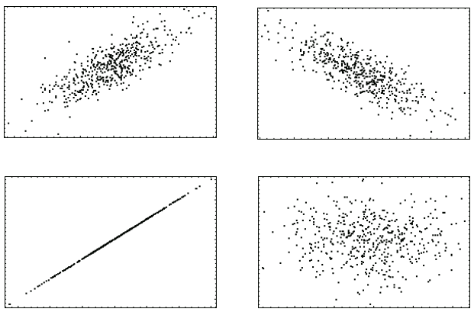
How “useful” is a single feature? : Univariate filters
Trying to predict someone’s ML exam grade from various possible indicators (a.k.a. features):
1) Statistics grade,
2) Biology grade,
3) Linear Algebra grade, or
4) Height ...
Which one would you pick?
Notes:
Many variables are correlated with each other and hence are redundant. If two variables are correlated, keeping one will help reduce dimensionality. But which variable to keep and which one to get rid off? Obviously, the one that has higher correlation.

Slide 7
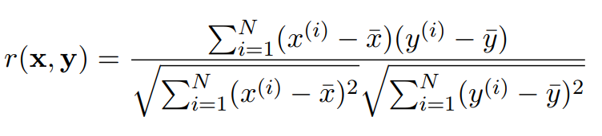
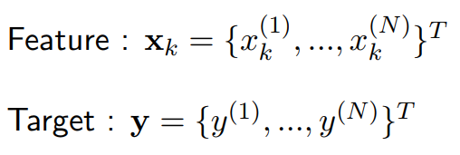
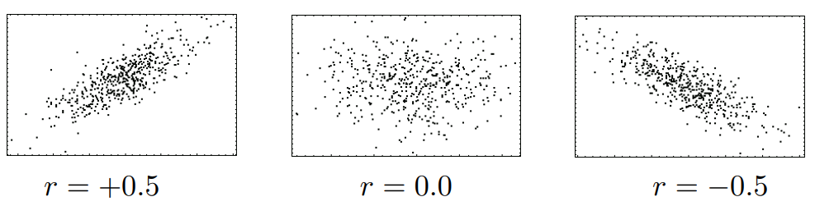
Pearson’s Correlation Coefficient
Used to measure the strength of association between two continuous random variables.
Both positive and negative correlation is useful!

Slide 8
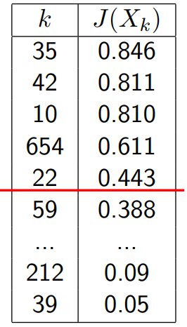
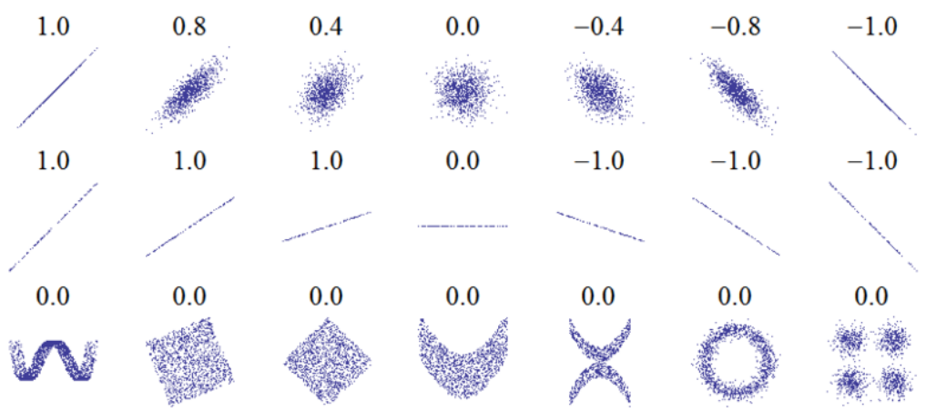
Ranking with Filter Criteria
Rank features X_{i} , ∀i by their values of J(X_{k}).
Retain the highest ranked features, discard the lowest ranked.
Cut-off point decided by user, e.g. |S| = 5,
S = {35, 42, 10, 654, 22}.
Limitation: Pearson assumes all features are INDEPENDENT ! and... only identifies LINEAR correlations.
Notes:
First, it helps remove features with near zero linear correlation to the class.
Second, it helps to reduce redundancy among selected features.
It is known that if data is linearly separable in the original representation, it is still linearly separable if all but one of a group of linearly dependent features are removed (Das, 1971). However, it is not safe to always assume linear correlation between features in the real world.
Linear correlation measures may not be able to capture correlations that are not linear in nature.
Another limitation is that the calculation requires all features contain numerical values.

Slide 9
There are LOTS of ranking criteria...
Pearson, Fisher, Mutual Info, Jeffreys-Matsusita, Gini Index, AUC, F-measure, Kolmogorov distance, Chi-squared, CFS, Alpha-divergence, Symmetrical Uncertainty,.... etc, etc
How do I pick the right filter ? Unfortunately, quite complex.... depends on:
type of variables/targets (continuous, discrete, categorical).
class distribution
degree of nonlinearity/feature interaction
The “No Free Lunch” theorem states that there is no universal model that works best for every problem.
Notes:
Many produce very similar rankings....
The No Free Lunch theorem in Machine Learning says that no single machine learning algorithm is universally the best algorithm. In fact, the goal of machine learning models is not find an algorithm that will be the best.
There is no single algorithm which has performed better in all scineraios

Slide 10
Thank You!
In our next session:Feature selection using Chi Squared Test

